Slide 1

The leyend of fionn mac cumhaill
Narrated by Daniela Montoya

Slide 2
Giant’s Causeway
The story goes that Fionn invited the Scottish giant, Benandonner, to visit Ireland for a contest of strength.

Slide 3
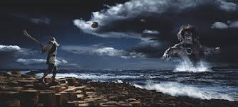

Slide 4
Fionn, deciding as an act of hospitality, to build a walkway between Scotland and Ireland so that Benandonner would not get his feet wet while he crossed the Irish Sea started to lay down the hexagonal stones.

Slide 5
